Slide 1
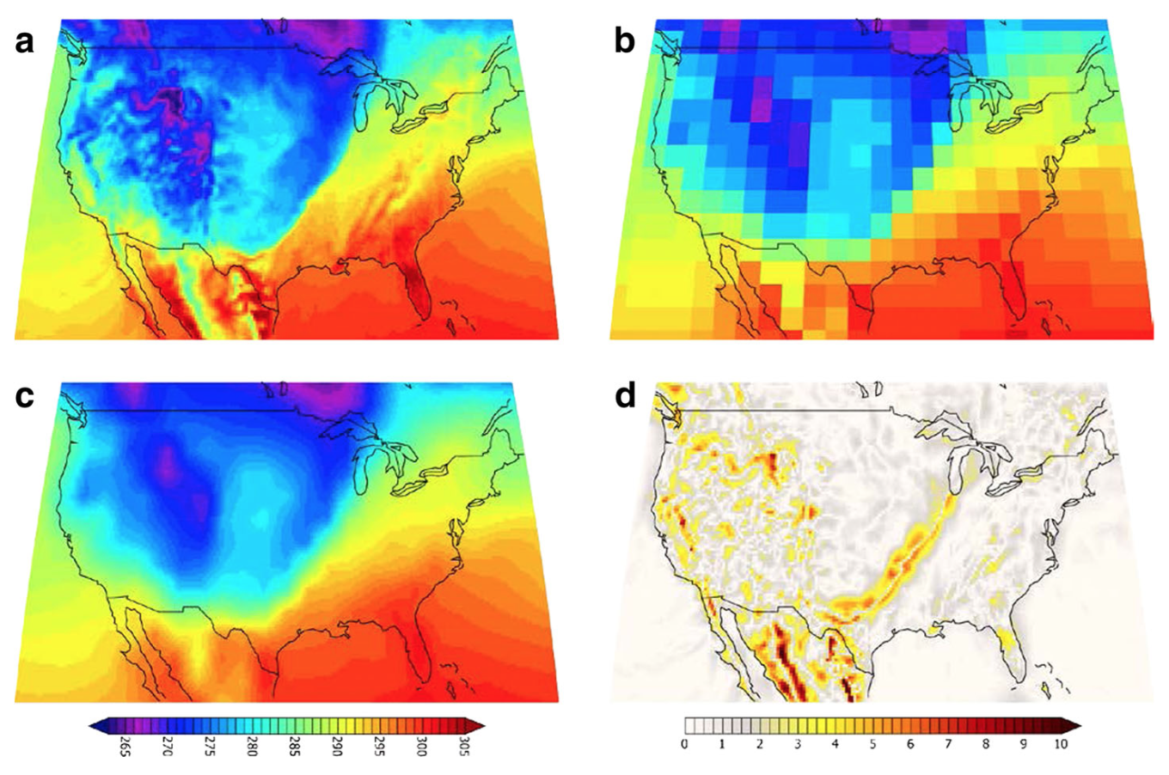


Comparing the performance of multiple statistical downscaling approaches using a perfect model framework
Anne Stoner¹, Katharine Hayhoe¹, Keith Dixon², John Lanzante², and Ian Scott-Fleming¹
¹ Climate Science Center, Texas Tech University, Texas, USA
²Geophysical Fluid Dynamics Laboratory, New Jersey, USA
Notes:
Photo Source: This work has been released into the public domain by its author, Palnordseth at the Norwegian (bokmål) Wikipedia project. This applies worldwide.

Slide 2
The Statistical Downscaling Conundrum
Most Empirical Statistical Downscaling Methods (ESDMs) are developed and applied after a cursory evaluation focusing on historical periods, to make sure the output is reasonable.
During development, ESDMs are not usually optimized to meet performance metrics but rather to produce a certain product, given specific inputs
For decades, the field has lacked a standardized comparison tool to evaluate and compare different SDMs on an equal footing -> both during and after evaluation

Slide 3
Stationarity assumption
One critical assumption implicit to all ESD methods is that of statistical stationarity, which presumes the statistical relationships between GCM output and observed climate data remain constant over time.

Slide 4
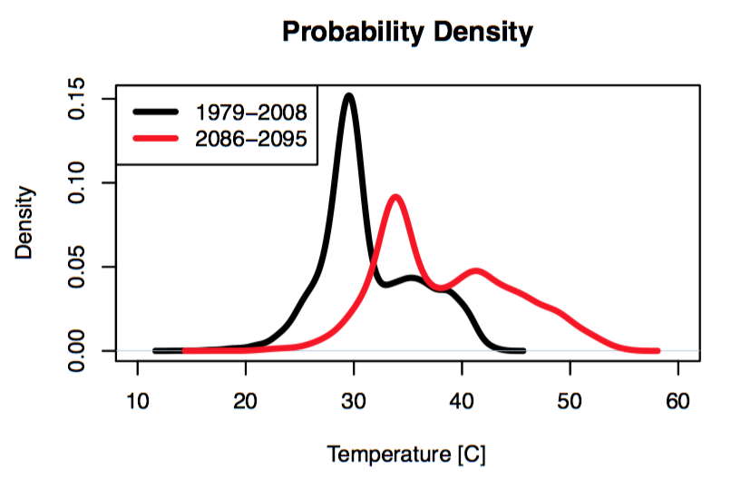
Stationarity assumption
One critical assumption implicit to all ESD methods is that of statistical stationarity, which presumes the statistical relationships between GCM output and observed climate data remain constant over time.
Notes:
----- Meeting Notes (3/6/17 23:39) -----
Even if the shape of the distribution changes over time, we assume that the statistical relationship between the observations and GCM still hold true.

Slide 5
ESDMs are traditionally evaluated on the historical period.
By dividing the historical record up into training and validation periods, producing downscaled output for a period that can be compared with independent observations
But how do we know if the model will perform equally well on future data? Will the stationarity assumption hold?

Slide 6
ESDMs are traditionally evaluated on the historical period.
By dividing the historical record up into training and validation periods, producing downscaled output for a period that can be compared with independent observations
But how do we know if the model will perform equally well on future data? Will the stationarity assumption hold?
We have developed a new “perfect model” framework to evaluate ESDMs and tests for stationarity in the future.
Using high-resolution GCM output as “observations” for the future, the ESDM is trained on historical high-resolution output and generates future projections that are compared with the dynamically-generated high-resolution projections.

Slide 7
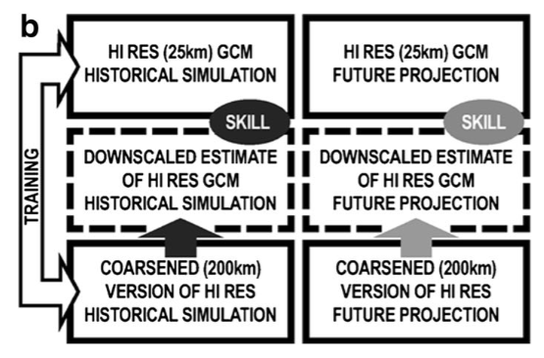
“Perfect model” experimental design

Slide 8
“Perfect model” experimental design

Slide 9
What are we using this framework to do?
FIRST, we coded up 3 frequently-used ESDMs (delta, quantile mapping, and ARRM), and compared their ability to reproduce high-resolution GCM simulations for the future, for a range of temperature and precipitation quantiles and impact-relevant thresholds.
Our comparison shows that simple methods can be adequate for some purposes, but complex methods are necessary for extremes.
Even complex methods can have problems in areas of rapidly varying topography, such as coastlines.

Slide 10
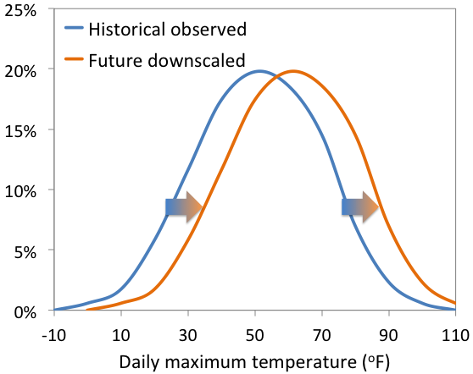
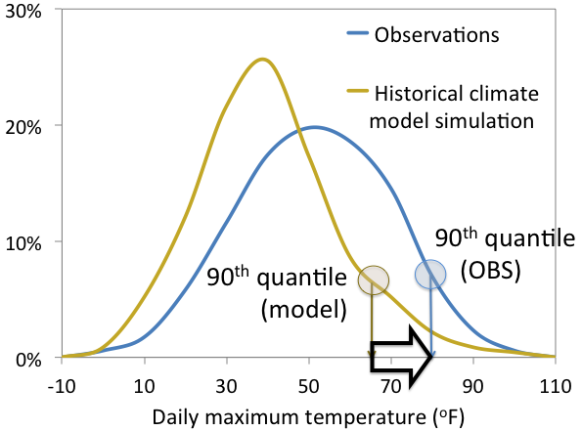
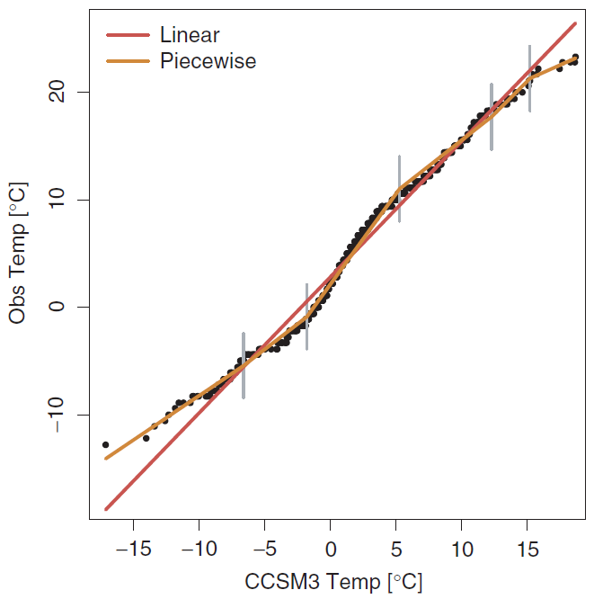
STEP ONE: Comparing 3 Existing ESDMs
ONE. THE DELTA METHOD
TWO. EMPIRICAL QUANTILE MAPPING (BCSD)
THREE. PARAMETRIC QUANTILE MAPPING (ARRM)

Slide 11
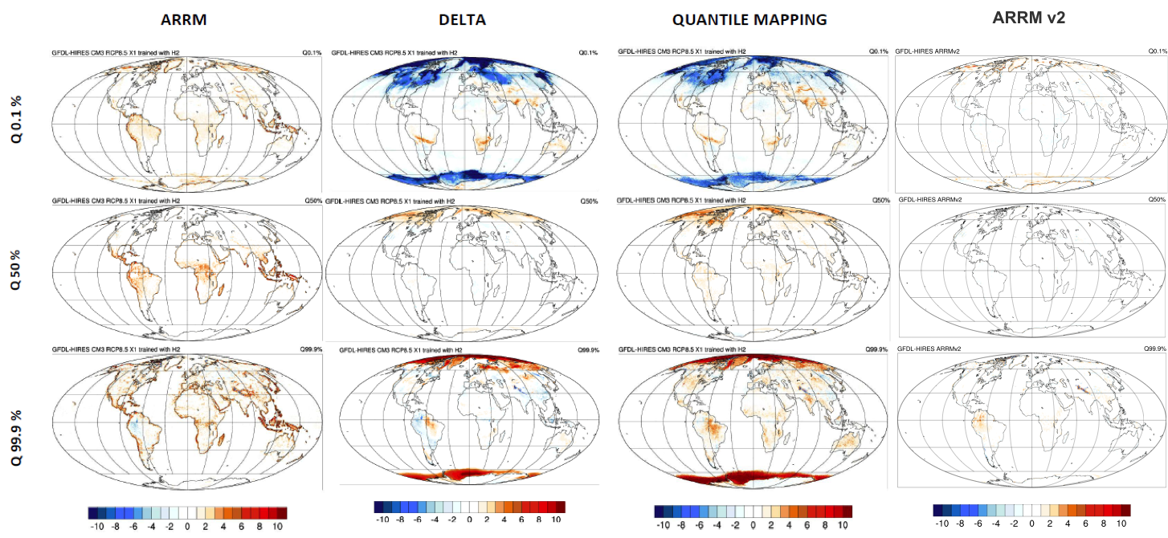
STEP ONE: Comparing 3 Existing ESDMs
Daily Maximum Temperature Bias 2086-2095

Slide 12
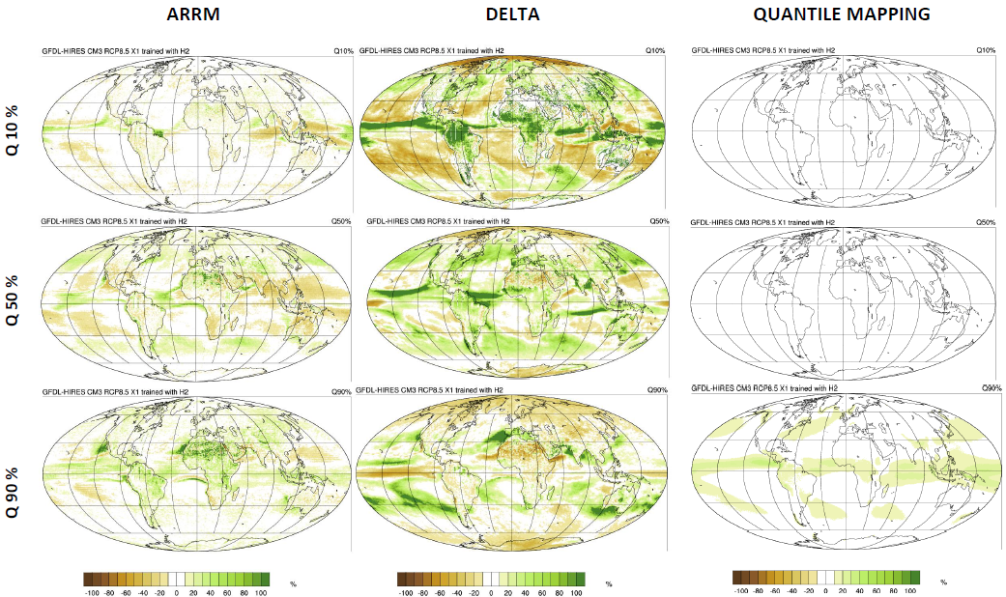
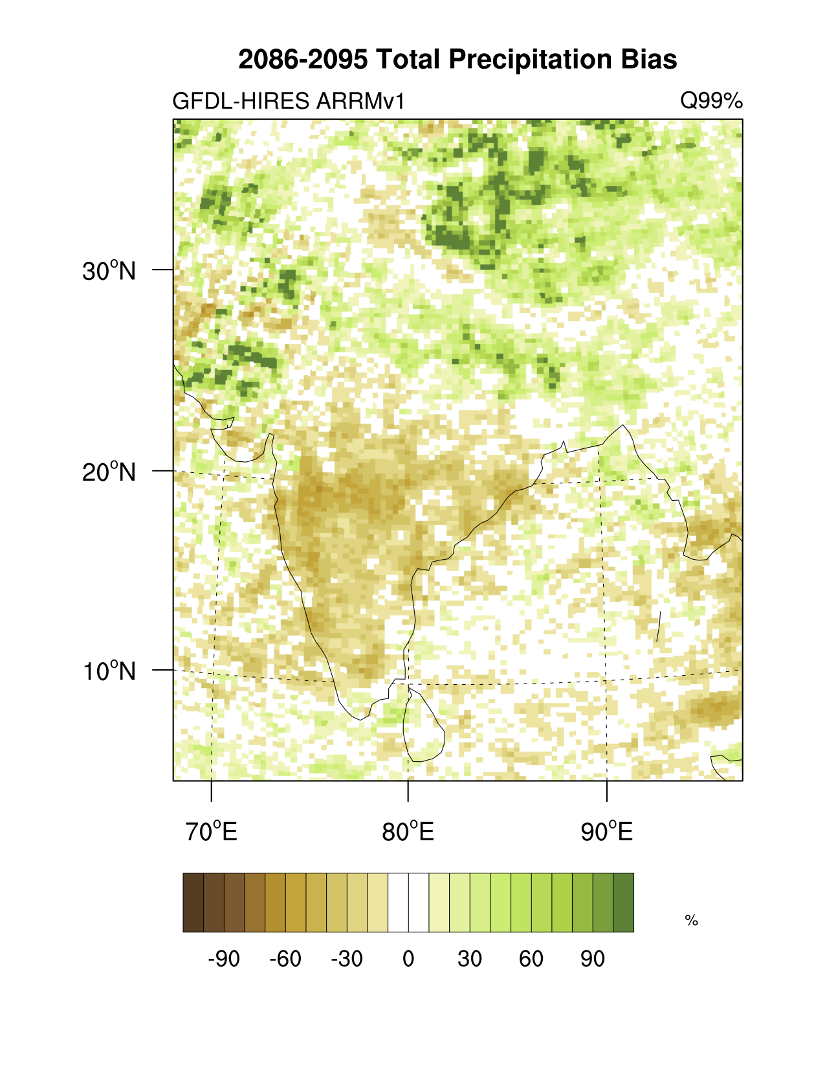
RESULTS: Daily Wet-Day Not-So-Extreme Precipitation Bias in 2086-2095

Slide 13
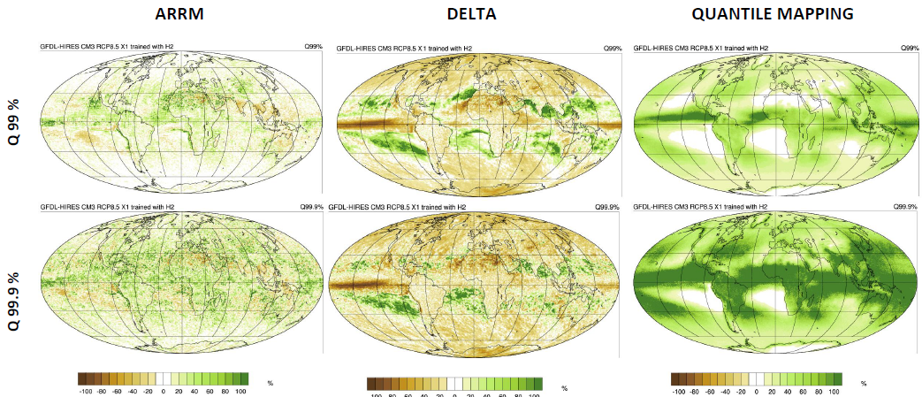
RESULTS: Daily Wet-Day Extreme Precipitation Bias in 2086-2095
Notes:
Note that ARRM1 is salt and pepper. Note also that ARRM2 results are forthcoming.

Slide 14
What are we using this framework to do?
SECOND, we just finished a brand-new non-parametric ESDM -- using the perfect model framework to evaluate and test the statistical methods and physical assumptions being made at every step along the way.
This process greatly increased the complexity of the new ESDM, but also its global relevance, as each aspect of the model was generalized to produce stationarity at any location, from Mt Everest to the Amazon.
The end result is ~100x more computationally efficient, with significantly reduced biases.

Slide 15
STEP TWO: Developing New ESDM
  The new non-parametric kernel density model (ARRM2) separates the signal into 4 separate components, and models each differently:
  ONE. Long-term trend TWO. Static annual climatology

Slide 16
STEP TWO: Developing New ESDM
  The new non-parametric kernel density model (ARRM2) separates the signal into 4 separate components, and models each differently:
  THREE. Dynamic climatology FOUR. High-frequency anomalies

Slide 17
STEP TWO: Developing New ESDM
  The model builds mappings between observations and GCM for the individual components.
  KDE (kernel density estimation) is used to estimate underlying PDFs.
  QQ (quantile-quantile) mapping creates a continuous mapping surface between 2 PDF distribution surfaces.
    ARRMv1 mapped on 12 independent monthly PDFs
    ARRMv2 maps on 365 correlated daily PDFs
OBSERVED HISTORICAL MODEL HISTORICAL DOWNSCALED HISTORICAL

Slide 18
STEP TWO: Developing New ESDM
  The final step is to recombine the four adjusted components to construct an estimate of the future signal.
  Adjusted Long-term trend
    LONG TERM TREND (MODEL) + (MEAN (OBS) – MEAN (HISTORICAL MODEL))
  Adjusted Climatology
    DYNAMIC CLIMATOLOGY(MODEL) + (STATIC CLIMATOLOGY (OBS) – STATIC CLIMATOLOGY (MODEL))
  Adjusted Anomalies
    Daily anomalies, with each day remapped so PDF surface of Model anomalies matches the PDF surface of Observations

Slide 19
RESULTS: Daily Maximum Temperature Bias in 2086-2095
Notes:
First, compare ARRM1 with Delta and BCSD, then second, focus on the improvement from ARRM1 to ARRM 2 (to lead into the next slide)

Slide 20
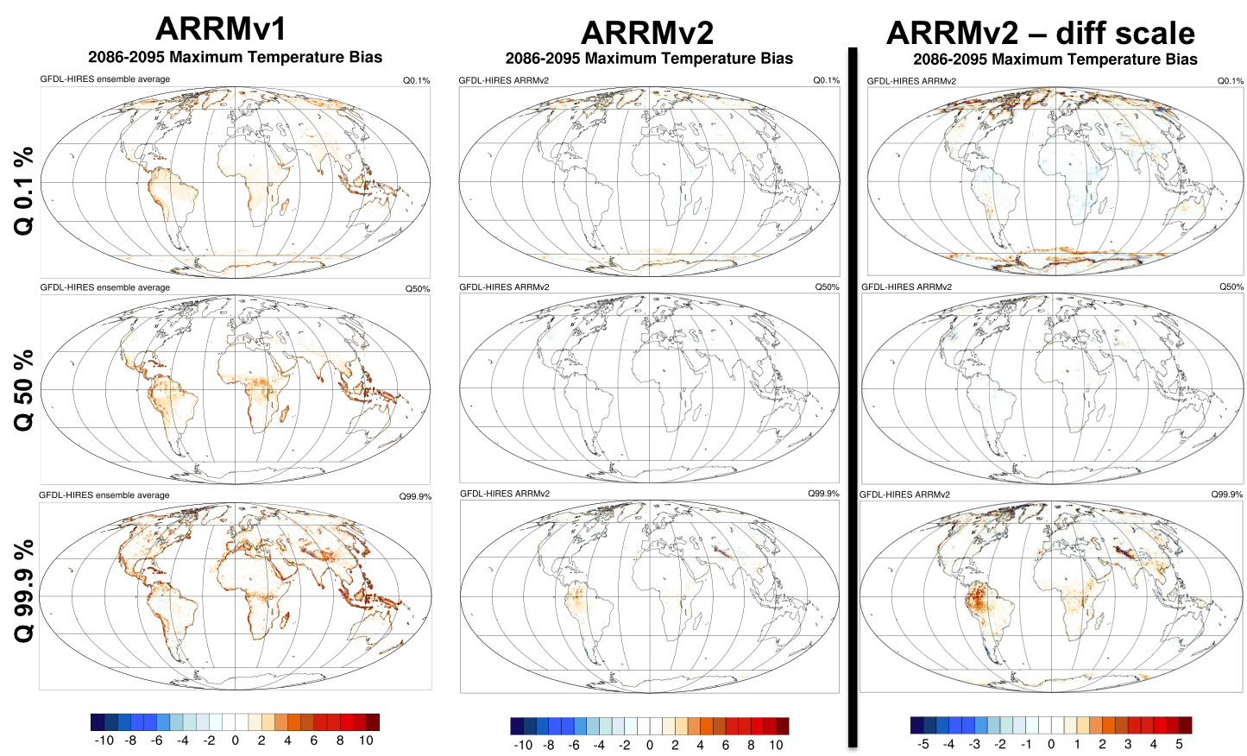
ARRM1 vs. ARRM 2 – does using the perfect model framework in development make a difference?
Notes:
We still have some issues in the Andes and the Himalayas. But other than that it looks DAMN GOOD! (make sure you say DAMN :)

Slide 21
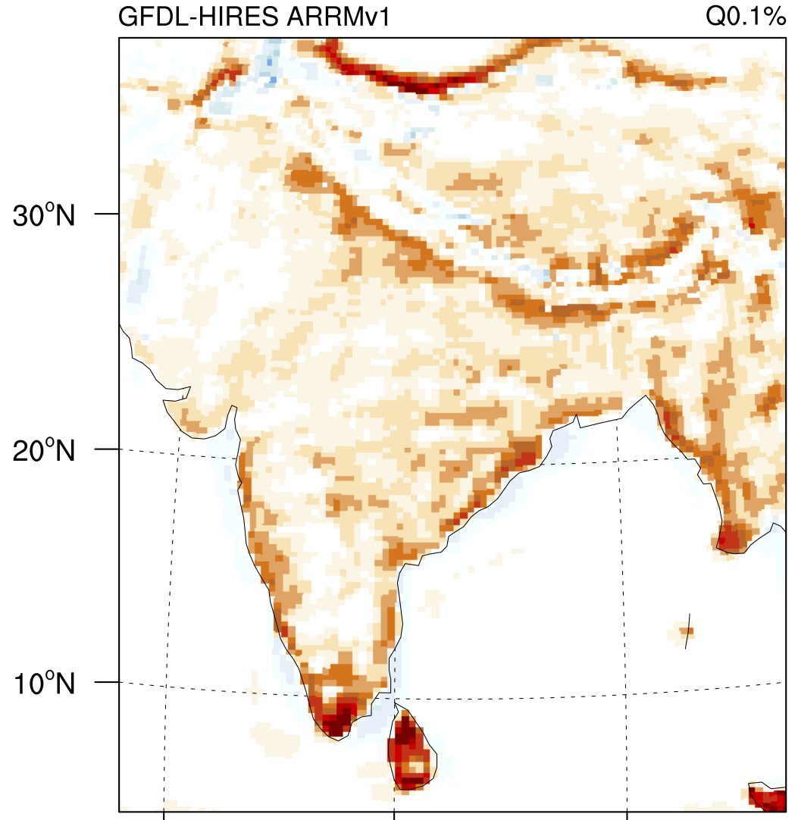
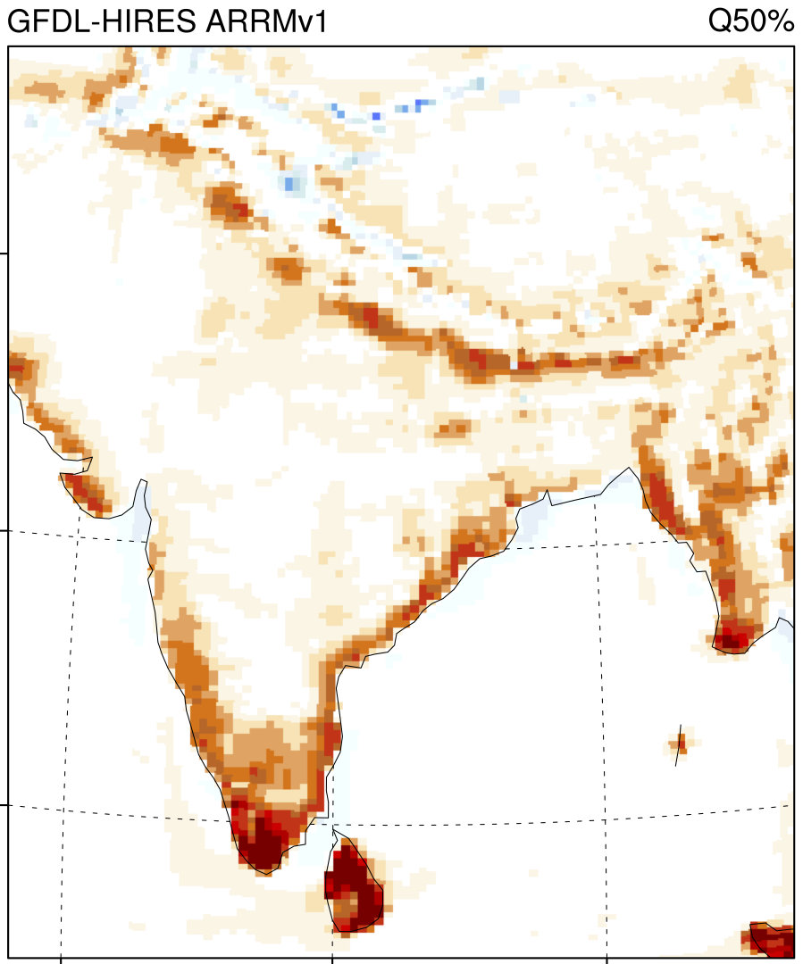
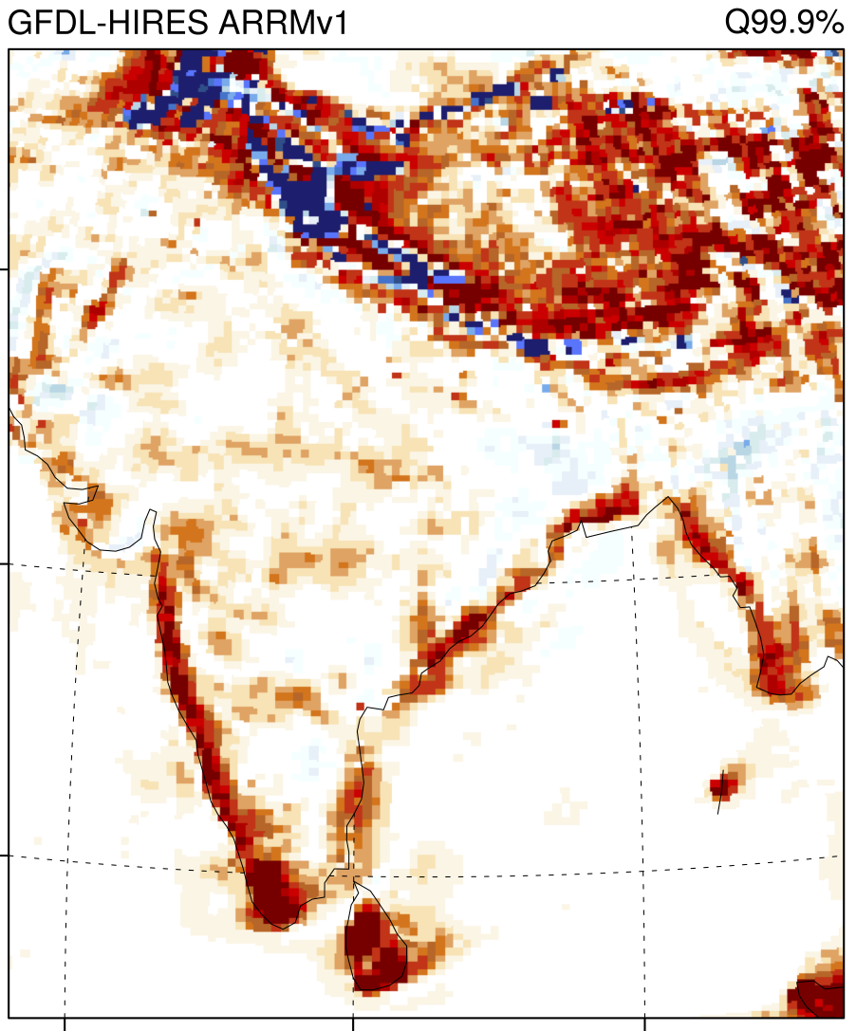
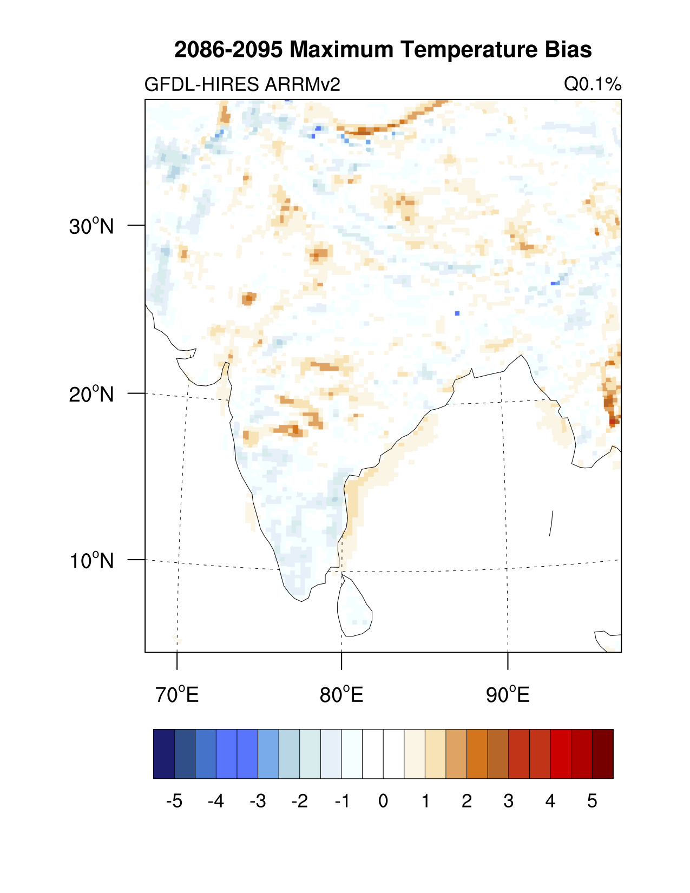
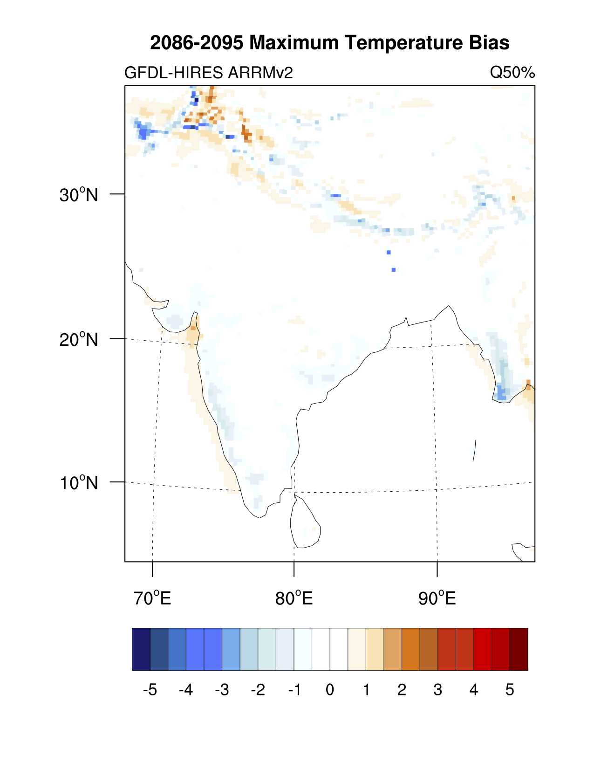
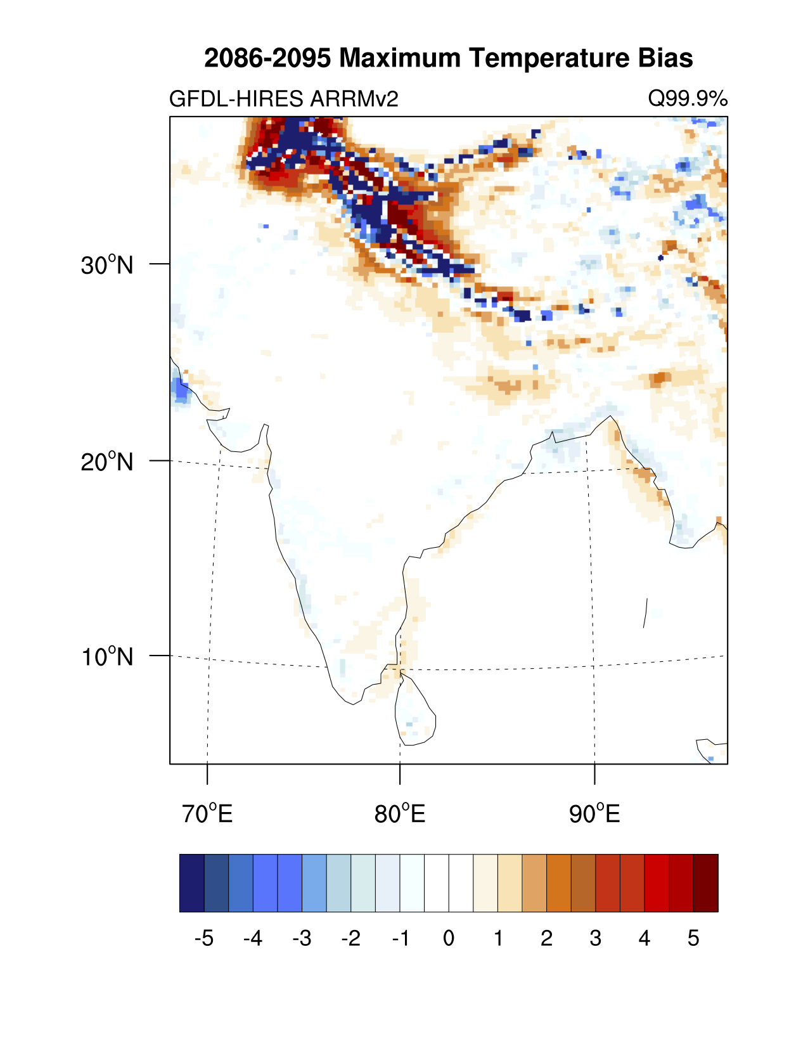
Q 0.01 %
Q 50 %
Q 99.9 %
ARRM v1
TASMAX
ARRM v2

Slide 22
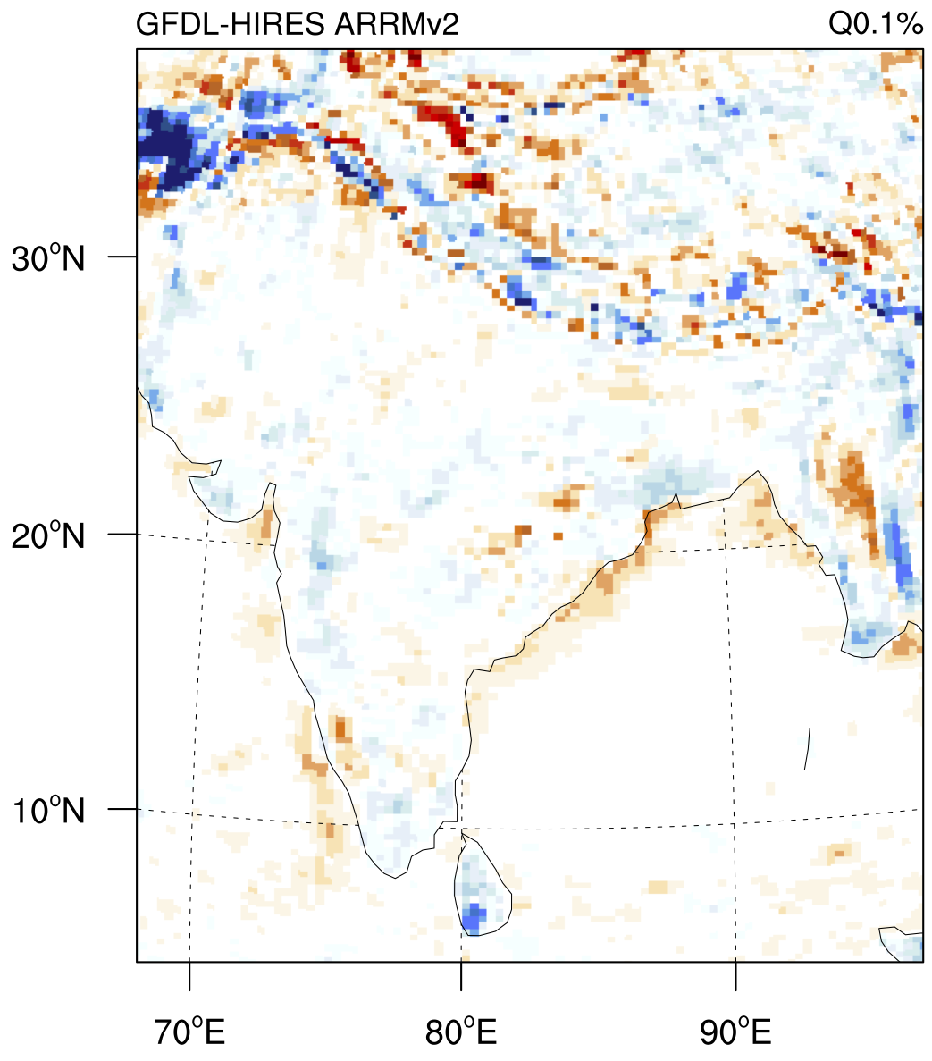
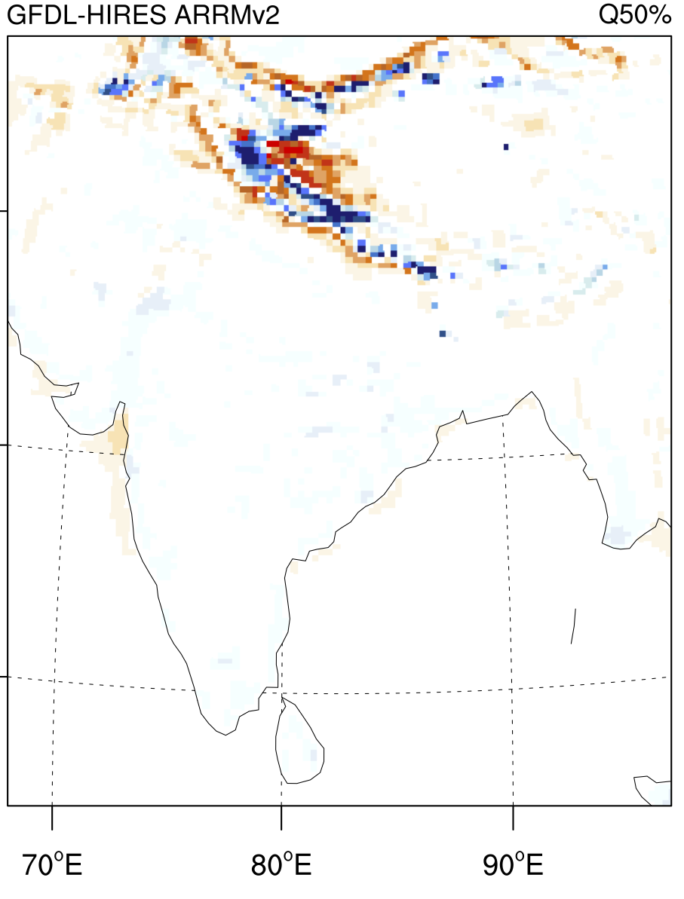
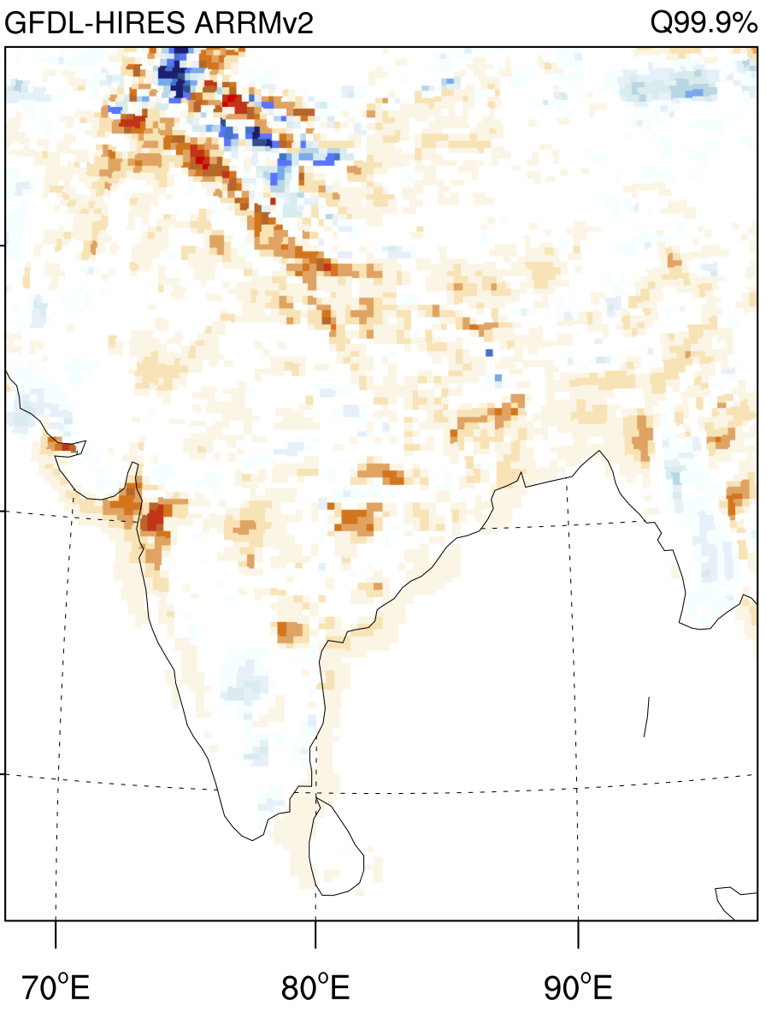
Q 0.01 %
Q 50 %
Q 99.9 %
TASMAX
ARRM v2
TASMIN

Slide 23
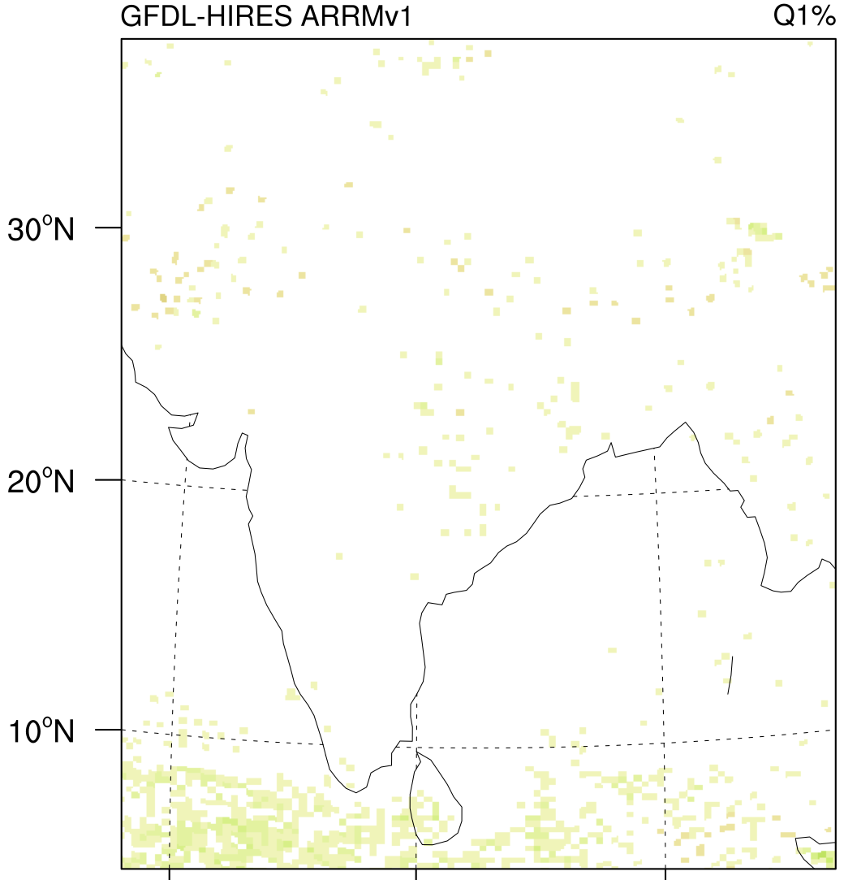
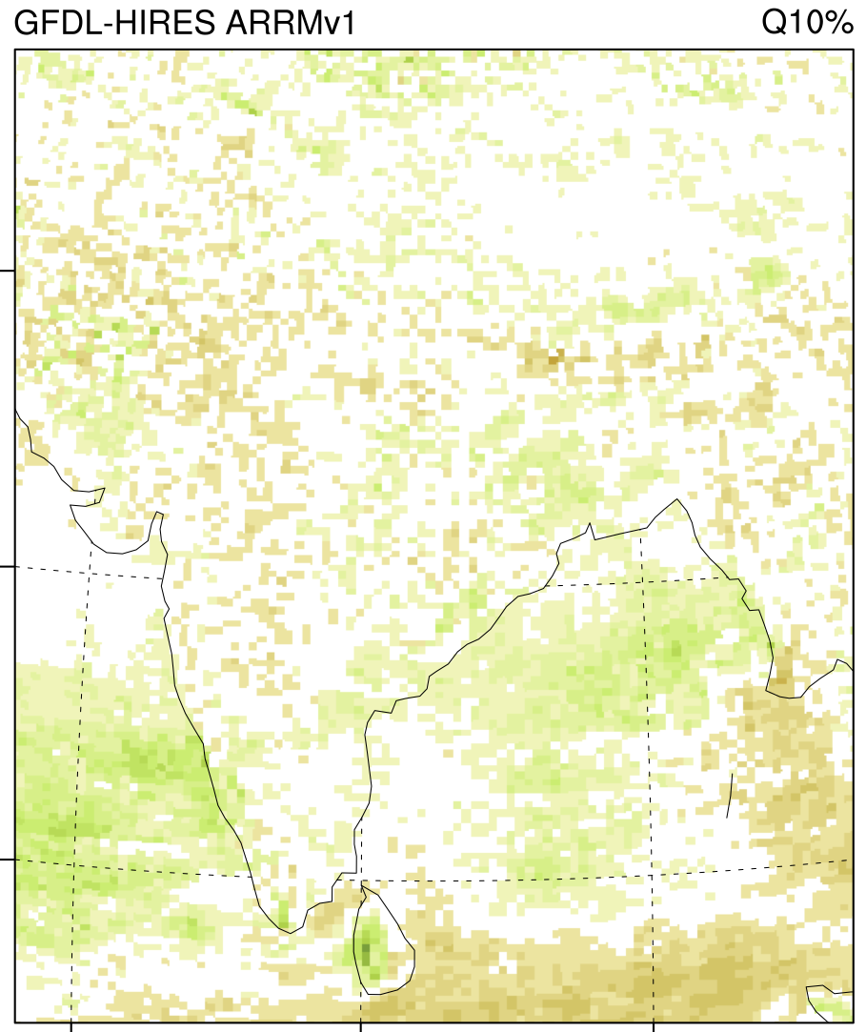
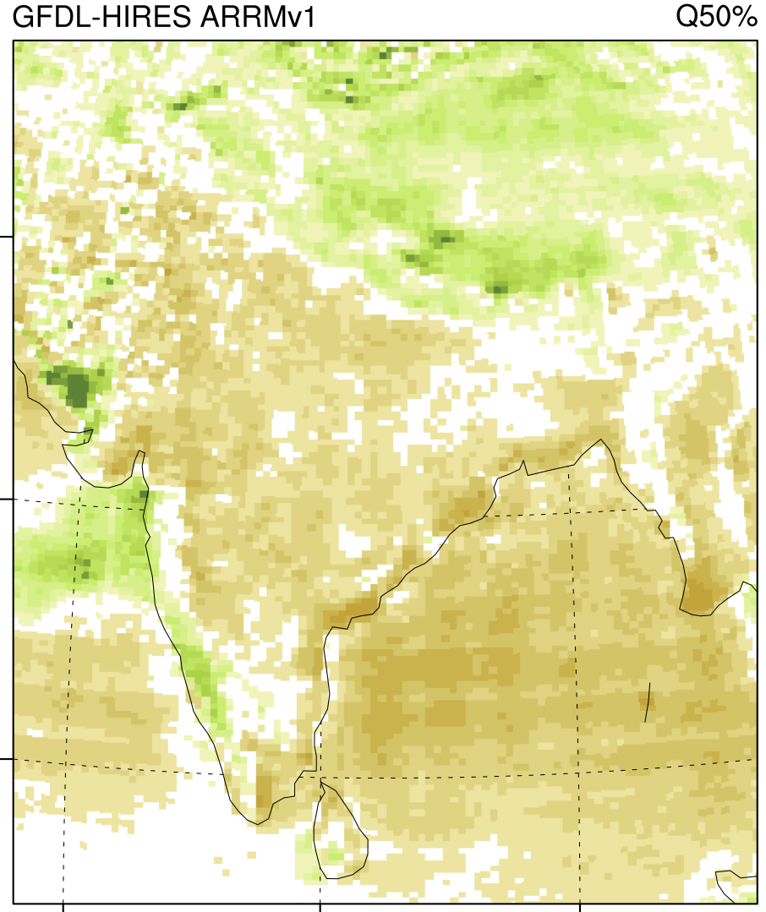
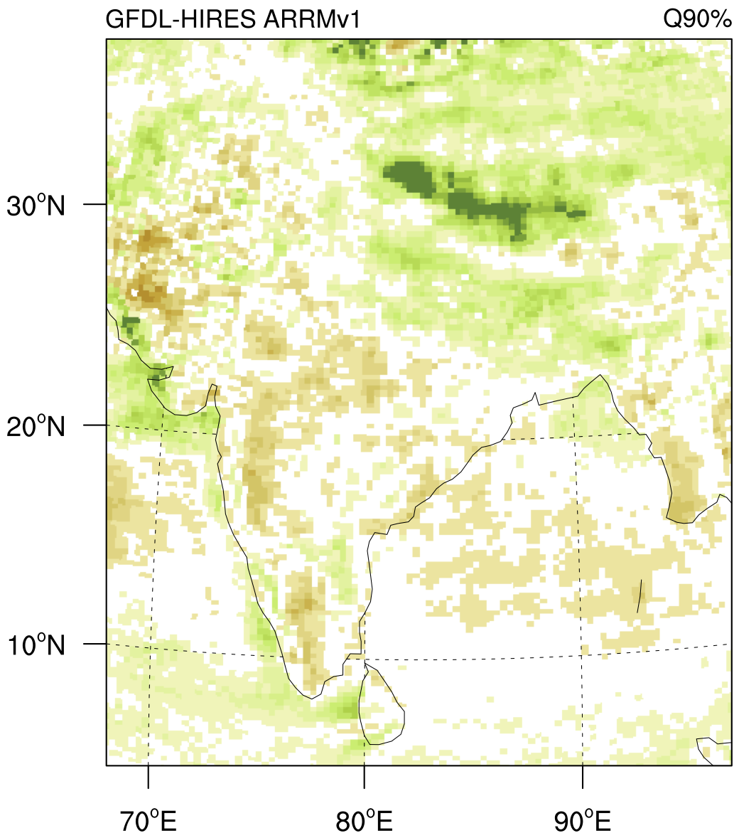
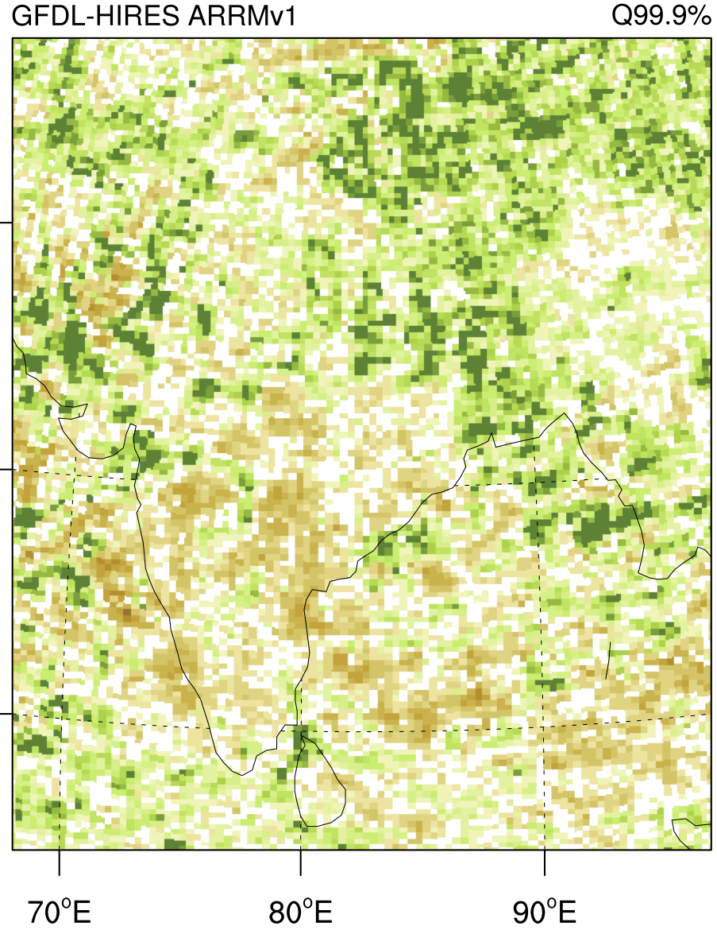
Q 1 %
Q 10 %
Q 50 %
Q 90 %
Q 99 %
Q 99.9 %
ARRM v1
PRECIPITATION

Slide 24
Does the stationarity assumption hold?
  DELTA
  Temperature: At mid to low latitudes, not at high latitudes
  Precipitation: In very few regions, definitely not in equatorial region
  EMPIRICAL QUANTILE MAPPING (BCSD)
  Temperature: More so in mid to low latitudes than high latitudes
  Precipitation: Excellent until 90th percentile, then rapid degradation

Slide 25
Does the stationarity assumption hold?
  PARAMETRIC QUANTILE MAPPING (ARRM v1)
  Temperature: Better inland than in coastal regions and winter than summer
  Precipitation: Reasonable until the 99th percentile, less so in equatorial regions
  NON-PARAMETRIC MAPPING (ARRM v2)
  Temperature: Shows improvement in many regions, particularly at the tails of the distribution
  Still a bias in very varied topographic regions (e.g. Himalayas)

Slide 26
CONCLUSIONS
The “perfect model” framework for evaluating downscaling methods consistently identifies geographic locations and quantiles at which the stationarity assumption is violated.
For temperature, all ESDMs show reasonable stationarity in the middle of the distribution in most regions but degrade toward the tails and at high latitudes, especially for simpler methods.
For precipitation, methods show sharp differences depending on the quantile of the distribution. This has important implications for application of ESDM output to impact assessment.
Using the “perfect model” framework as a development tool has created an ESDM with biases at least equal to, and generally lower than, its predecessor; upcoming research will test ARRMv2 biases in precipitation and relative humidity.

Slide 27
For the climate data exercise, we are using:
6 CMIP5 Global Climate Models (GCMs), selected for their ability to reproduce the Indian Monsoon and their long development history
  CCSM4
  GFDL-ESM2G
  IPSL-CM5A-LR
  MIROC5
  MPI-ESM-LR
  MRI-CGCM3
2 future Representative Concentration Pathways (RCPs)
  The higher RCP 8.5
  The mid-low RCP 4.5

Slide 28
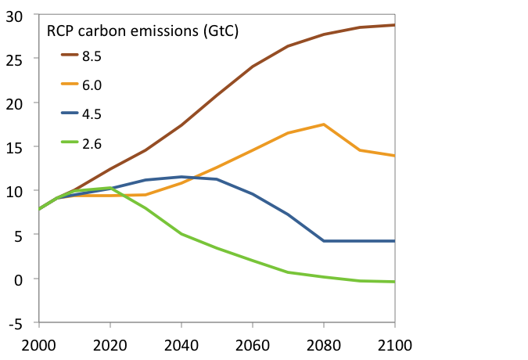
Two Future Scenarios: Higher and Lower
Continued reliance on fossil fuels,
but with much greater efficiency than today.
Developed nations’ emissions peak, then decline, while developing nations’ emissions growth continues.

Slide 29
Two Future Scenarios: Higher and Lower
Transition to alternative energy sources.
Developed nations reduce emissions ~80% by 2050
Developing nations participate in emission reductions.

Slide 30
For the climate data exercise, we are using:
6 CMIP5 Global Climate Models (GCMs), selected for their ability to reproduce the Indian Monsoon and their long development history
2 future Representative Concentration Pathways (RCPs)
3 variables: daily maximum and minimum temperature, 24 hour cumulative precipitation

Slide 31
For the climate data exercise, we are using:
64 out of 79 long-term weather stations that have sufficient daily maximum and minimum temperature and 24 hour cumulative precipitation to be downscaled

Slide 32
For the climate data exercise, we are using:
6 CMIP5 Global Climate Models (GCMs), selected for their ability to reproduce the Indian Monsoon and their long development history
2 future Representative Concentration Pathways (RCPs)
3 variables: daily maximum and minimum temperature, 24 hour cumulative precipitation
64 out of 79 weather stations
2 sets of downscaled projections
  Projections for individual weather stations, downscaled using ARRMv2 (for temperature) and ARRMv1 (for precipitation)
  Gridded projections covering all of India, downscaled using NASA NEX

Slide 33
THANK YOU!

